Slide 1






Demystifying CXL Memory with Genuine CXL-Ready Systems and Devices
¹Yan Sun, ²Yifan Yuan, ¹Zeduo Yu, ¹Reese Kuper, ¹Chihun Song, ¹Jinghan Huang, ¹Houxiang Ji,
¹Siddharth Agarwal, ¹Jiaqi Lou, ¹Ipoom Jeong, ²Ren Wang, ³Jung Ho Ahn, ¹Tianyin Xu, ¹Nam Sung Kim
¹University of Illinois Urbana-Champaign
²Intel Labs
³Seoul National University
Notes:
Thanks for the introduction, Hi everyone, today, I will be presenting our recent work in demystifying CXL memory with genuine CXL-ready system and devices.
This is a collaboration between University of Illinois, Intel and the Seoul National University.

Slide 2
















CXL (Compute eXpress Link)
Introduced since 2019
Built on top of PCIe, but new features
CXL.cache (cache coherence)
CXL.mem (memory expander)
The CXL Consortium
Notes:
<click>
The CXL standard was introduced in 2019.
<click>
In a high-level, it uses the high-speed and low latency PCIe link but provides a rich set of features / including
<click> CXL.cache for device to host cache coherence
<click> And CXL.mem for host to device cache-able memory accesses.
<click> As of today, the CXL consortium has gathered 15 board directors, more than 70 contributors, and hundreds of adopters.

Slide 3
CXL Type3
Hardware native load-store
Software as a CPU-less NUMA node
CXL Type3 Device
CPU
CXL
Ctrl
DIMM
DIMM
DIMM
DIMM
DIMM
DIMM
DIMM
DIMM
Mem ctrl
PCIe link
Mem ctrl
CXL / PCIe
CXL / PCIe
DIMM
DIMM
DIMM
DIMM
DIMM
DIMM
DIMM
DIMM
Notes:
In this work, we focus our discussion on CXL type 3 devices, which is meant to be a memory expander.
<click>
On the hardware-level, it supports native CPU load store operation on the devices’ memory.
<click>
And on the software-level, it is exposed to the system as a CPU-less NUMA node.
Here is an illustration of how CXL Type3 transforms the conventional memory hierarchy.
<click>
Traditionally, a CPU has on-chip memory-controller, which controls some memory channels and corresponds to several DIMM slots.
Note that to scale the memory, we need to introduce more memory controllers as well as more DIMM slots.
CXL Type 3 disaggregates the memory channels by
<click> (mem ctrl move)
first decoupling the memory controller from the CPU.
<click>
then implements a CXL controller within the CPU
<click>
And with an external CXL controller on the Type 3 device
<click>
The host can now use the decoupled memory through the serial PCIe link.
<click>
Note that we may chain arbitrary kind of memory and huge number of memory chips on the Type3 device, making it cost-efficient to scale.

Slide 4
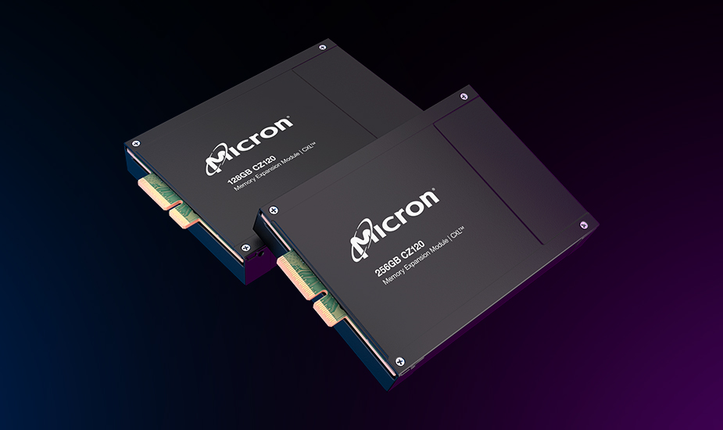
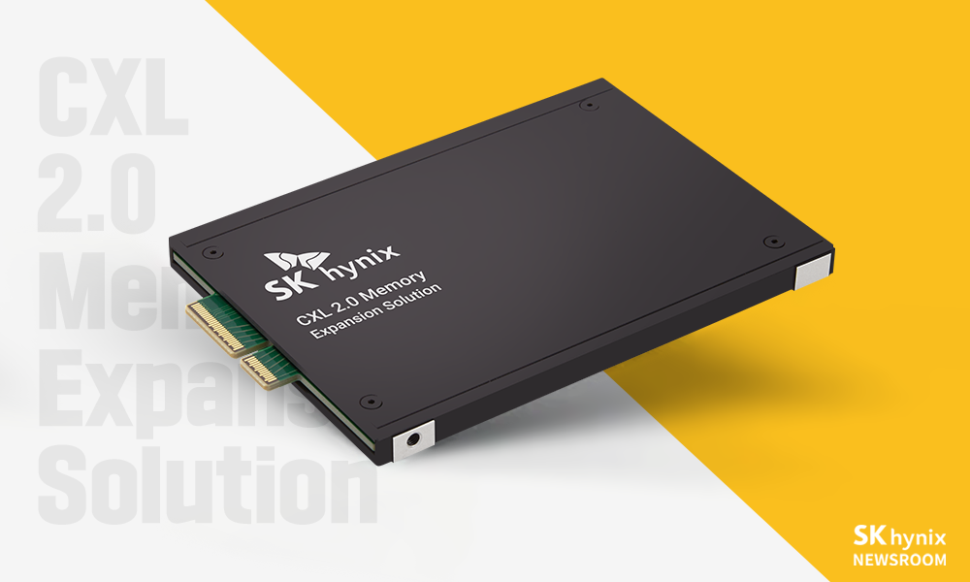

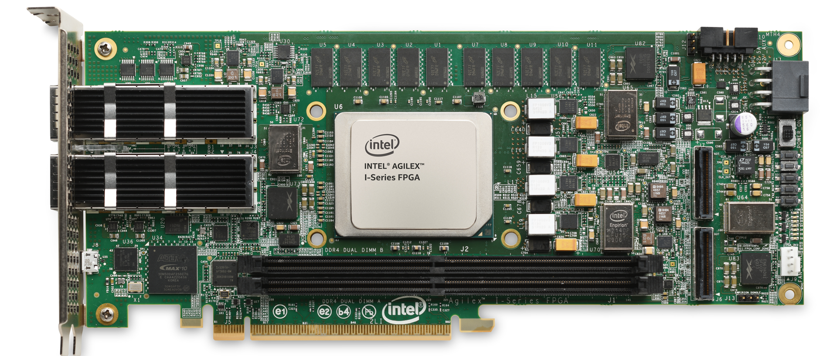
CXL Type3
Hardware native load-store
Software as a CPU-less NUMA node
CXL memory is emerging in the industry
Notes:
Since its introduction, it attracted much attention from the industry.
<click, show until agilex>
Various companies start to build their own CXL memory devices.

Slide 5




CXL Type3
Hardware native load-store
Software as a CPU-less NUMA node
CXL memory is emerging in the industry
And in the academia
However, most works were done with
emulated-CXL systems
Notes:
At the same time, the academia is even more fanatic about this new link.
<click>
New computing concepts with CXL were proposed in an amazing speed.
<click>
HOWEVER. Most of these works were done with NUMA emulated systems rather than TRUE CXL devices.

Slide 6
This work – the first work based on real hardware
Understanding the intrinsic of CXL memory in real system
CXL != NUMA
CXL can have a lower latency than NUMA
CXL can have a better transfer efficiency than NUMA
Using CXL well is not easy
Using it wrong can introduce access latency penalty ❌
Using it right can bring significant performance gain ✅
CXL can be used as a bandwidth expander
Make the most efficient use out of CXL memory
Notes:
<click>
As the first work on demystifying the TRUE behavior of CXL on the latest systems, this work attempts to bridge the gap between how people imagine CXL and how CXL performs in the state-of-the-art systems.
Here are the high-level summary of our findings.
<click>
First, CXL exhibits some unique characteristics due to its design as well as the host CPU hardware, which makes it very different from the NUMA memory.
<click>
In some cases, CXL can have a lower latency or better transfer efficiency than NUMA.
<clikc>
Second, using CXL well is not easy.
<click>
The latency of CXL is still higher than local-socket DDR5, and therefore, using CXL wrong can introduce penalty in access latency.
<click>
Meanwhile, we found that using CXL for the right software components or in the right ratio / can bring significant performance gain.
<click>
Finally, we propose to use CXL as a memory bandwidth expander, and we developed a scheme to automatically tune for the best CXL memory ratio, for such use cases.

Slide 7

With True CXL devices and systems
 | DDR5-R | CXL-A | CXL-B | CXL-C
CXL IP | - | Hard IP | Hard IP | Soft IP
Memory Controller | - | Hard IP | Hard IP | Soft IP
Memory technology | DDR5-4800 x1 | DDR5-4800 x1 | DDR4-2400 x2 | DDR4-3200 x1
 | CXL-A | CXL-B | CXL-C
CXL IP | Hard IP | Hard IP | Soft IP
Memory Controller | Hard IP | Hard IP | Soft IP
Memory technology | DDR5-4800 x1 | DDR4-2400 x2 | DDR4-3200 x1
Intel 4th Gen. Xeon Scalable Processor
(Codenamed Sapphire Rapids, SPR)
Notes:
With the latest Intel 4th generation Xeon scalable processor,
<click>
we tested 3 CXL devices, each with a unique implementation on their CXL IP and memory technology.
<click>
And to further identify what’s missing in the prior NUMA-emulated work on CXL systems, we tested the characteristic of a single-channel remote socket memory and compare low-level details with micro-benchmarks.

Slide 8
Micro-benchmarking 🔍
Intel MLC
The de facto tool for testing memory systems
Latency
Throughput
More …
memo 📝
House-made tool for fine-grain memory profiling
Written in C / x86 asm
{ld, nt-ld, st, nt-st, movdir64B}
Latency
Throughput
Open-sourced
Notes:
To discover the true characteristic of CXL memory on real systems, we start by testing these devices with two microbenchmarks.
<click>
First, we use the Intel memory latency checker or MLC, the de facto tool for testing memory systems.
<click>
We used it to extract the basic latency and throughput of the devices.
<click>
Next, we built our own microbenchmark called memo.
<click>
It is written in C and x86 assembly / and supports specific operations like load, non-temporal load, store, non-temporal store, and the latest move-dir-64-B instruction.
<click>
It can profile both latency and throughput of these instructions /
<click>
and it is open-sourced for everyone to play with.

Slide 9
Micro-benchmarking 🔍 – Latency
CXL memory latency depends on the controller
Differ by 2 - 3x
CXL does not always have a higher latency than NUMA
Cache-coherence
Details in the paper
Hard IP + DDR5 = lower latency
Hard IP latency < Soft IP
CXL-A & CXL-B has lower latency than NUMA
 | DDR5-R | CXL-A | CXL-B | CXL-C
CXL IP | - | Hard IP | Hard IP | Soft IP
Mem Ctrl | - | Hard IP | Hard IP | Soft IP
Mem Tech. | DDR5-4800 x1 | DDR5-4800 x1 | DDR4-2400 x2 | DDR4-3200 x1
Notes:
Using these micro-benchmarks, we collected the memory latency of the three CXL devices and the remote socket NUMA under five cases.
The bars on the right shows the normalized latency values.
<click>
In the case of MLC, we found that CXL-B outperforms CXL-C even though it is using a memory with slower clock.
<click>
This indicates that CXL memory latency depends heavily on its CXL controller’s design.
<click>
On the other hand, CXL does not always have a higher latency than NUMA setups.
<click>
Focusing on the non-temporal store latencies on the right bars, we found that two out of three CXL devices have a lower latency value than the remote socket DDR5.
<click>
We attribute such difference to the cache-coherence optimization that CXL enjoys. Please refer to the paper for the in-depth insights.

Slide 10
Micro-benchmarking 🔍 – Bandwidth
Efficiency = BW / Theo. Max BW
ld efficiency is better on NUMA
Better memory controller on CPU
st efficiency can be better on CXL
Cache-coherence
CXL IP impl. matters a lot!
Hard CXL IPs have clear advantage
 | DDR5-R | CXL-A | CXL-B | CXL-C
IPs | - | Hard IP | Hard IP | Soft IP
Mem Tech. | DDR5-4800 x1 | DDR5-4800 x1 | DDR4-2400 x2 | DDR4-3200 x1
Notes:
After seeing the dynamic latency of CXL, let’s turn our focus to the bandwidth of these devices.
<click>
The figures on the right shows the efficiency value calculated as “bandwidth observed” over “theoretical maximum bandwidth”.
<click>
First, we observed that load efficiency is better on the single-channel remote socket DDR5. We believe this is because the CPU has a better memory controller than the CXL devices.
<click>
On the other hand, the store efficiency of the CXL devices can be better than that of remote socket DDR5.
This is because the cache-coherence optimization that CXL enjoys.
<click>
Finally, the implementation and the design of a CXL device matters a lot.
Not only does it impact the latency / but also greatly affect the access efficiency.
In all cases, an ASIC-based CXL device provides a better access efficiency than an FPGA-based CXL device.

Slide 11




Real-World Application
Latency-critical applications
Redis¹: In-memory database
DeathStarBench²: Micro-service benchmarks
FIO³: Flexible I/O Tester
Throughput-oriented applications
Redis¹: (max QPS)
DLRM⁴: Deep-learning recommendation model inferencing
(YCSB-Redis) https://github.com/brianfrankcooper/YCSB/tree/master/workloads
(DeathStarBench) https://github.com/delimitrou/DeathStarBench
(FIO) https://github.com/axboe/fio
(DLRM) https://github.com/SNU-ARC/MERCI
Notes:
With these interesting characteristics in mind, let’s see how applications perform when having their memory allocated to CXL!
<click>
First, we tested CXL memory with Redis,
<click>
the Death-Star-Bench micro-service benchmark,
<click>
and Linux file cache.
For this group of application, they are considered as latency critical application, as the tail latency is the metric here.
<click>
Next, we tested CXL memory with Redis,
but this time for the maximum achievable query-per-second,
<click>
and we also tested multi-threaded inference for deep-learning-recommendation-model.
For this group of application, the throughput is the metric.

Slide 12
Latency critical
Perf. loss!
Perf. gain!
Use CXL wisely for latency critical app
Notes:
When CXL memory is used by latency critical applications, the penalty may vary depending on the workload.
<click>
For example, for the highly-optimized in-memory database, like Redis, their micro-second-level query latency may experience a notable penalty when their memory is allocated to CXL.
<click>
The graph on the left shows the 99-th percentile latency of Redis. We see a huge increase in 99-th percentile latency when all memory is allocated to CXL.
<click>
Meanwhile, for micro services that operates on milli-second level latency, and with layers of intermediate computations, we found that using CXL memory can bring benefits.
The graph on the right shows the 99-th percentile latency of the social-network micro services in the Death-Star-Bench benchmark.
The difference between the yellow and the green line is that we put all database memory on CXL for the green line, and on the DDR5 for the yellow line.
The rest of the micro-service components are all on DDR5.
<click>
Note that the green line has a significantly lower latency than the yellow line for several QPS, which indicates that the memory bandwidth offloading offered by CXL memory can bring true performance benefits.
<click>
The result of these applications shows that we must use CXL memory for the right application.

Slide 13
Throughput oriented
Perf. always decreases!
Perf. gain!
Single-threaded Redis
Multi-threaded DLRM
Is my application memory bandwidth bounded? 🤔
CXL as memory
bandwidth expander 👍
Notes:
For applications that uses throughput as a metric, we found that CXL memory can also bring performance gain, if we use it wisely.
<click>
In single-threaded application, like Redis, we found that putting any amount of memory on CXL can lead to performance lost.
This is because a single-threaded application draws limited load-store bandwidth from the memory, therefore the memory bandwidth is not the bottleneck here.
<click>
For multi-threaded applications, like inferencing for deep-learning-recommendation-model, we found that as the thread count increases, DRAM bandwidth becomes the bottleneck.
<click>
The red dashed line outlines the inference throughput of using only DRAM. We see that the inference throughput max out at 16 threads.
<click>
On the other hand, the yellow dashed line outlines the best inference throughput achieved by interleaving some memory traffic to CXL.
<click>
In this case, we see a linear scaling of the throughput, as CXL provide extra memory bandwidth to the system.
<click>
The experiment in DLRM shows that CXL has the potential of being used as a memory bandwidth expander,
<click>
and this should used only when the application is memory bandwidth bounded.

Slide 14
Throughput oriented applications
Perf. always decreases!
Perf. gain!
Single-threaded Redis
Multi-threaded DLRM
Is my application memory bandwidth bounded? 🤔
CXL as memory
bandwidth expander 👍
Notes:
For applications that uses throughput as a metric, we found that CXL memory can also bring performance gain, if we use it wisely.
<click>
In single-threaded application, like Redis, we found that putting any amount of memory on CXL can lead to performance loss.
This is because a single-threaded application draws limited load-store bandwidth from the memory, therefore the memory bandwidth is not the bottleneck here.
<click>
For multi-threaded applications, like inference for deep-learning-recommendation-model, we found that as the thread count increases, DRAM bandwidth becomes the bottleneck.
<click>
The red dashed line traces the inference throughput of using only DRAM. We see that the inference throughput max out at 16 threads.
<click>
On the other hand, the yellow dashed line traces the best inference throughput achieved by interleaving some memory traffic to CXL.
<click>
In this case, we see a linear scaling of the throughput, as CXL provide extra memory bandwidth to the system.
<click>
The experiment in DLRM shows that CXL has the potential of being used as a memory bandwidth expander,
<click>
and this should be used only when the application is memory bandwidth bounded.

Slide 15
How to expand bandwidth? Interleaving!
Page placement
Interleave (default)
Interleave (N:M interleave)
Not all CXL device are created equal
Variety of bandwidth
Each need a different ratio
What is the right ratio? 🤔
NUMA
Node 0
NUMA
Node 1
Page
Page
Page
Page
Page
Page
Page
Page
Page
Page
Page
Page
Page
Page
Page
Page
Interleave
Page
Page
Page
Page
Page
Page
Page
Page
Page
Page
Page
Page
Page
Page
Page
Page
Interleave 3:1
Notes:
To dig deeper into how memory should be placed on CXL, let’s go over some background on the memory allocation scheme / provided by Linux / for NUMA systems.
<click>
The default memory interleaving provided by the Linux Kernel will allocate memory in a round-robin fashion to the specified node. Such allocation is done in the page granularity.
<click>
For example, suppose there are two NUMA nodes,
<click>
the first page will go to node 0, Second page will go to node 1, Third to node 0 again, Fourth to node 1, So on and so forth.
<click>
A recent Kernel patch enhanced the interleave mode by allowing the user to specify a weight for the round-robin allocation.
<click>
For example, if the user want to allocate 25% of memory on CXL, they may set the kernel parameter to 3 to 1 before the allocation.
<click>
Also, due to the openness of CXL protocol, every CXL memory device can exhibit distinct characteristics, as shown before
<click>
This can lead to variety of available bandwidth, and thus different best interleaving ratios.
<click>
With that in-mind, how can one choose the right ratio to achieve the optimal throughput?

Slide 16

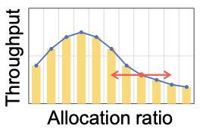

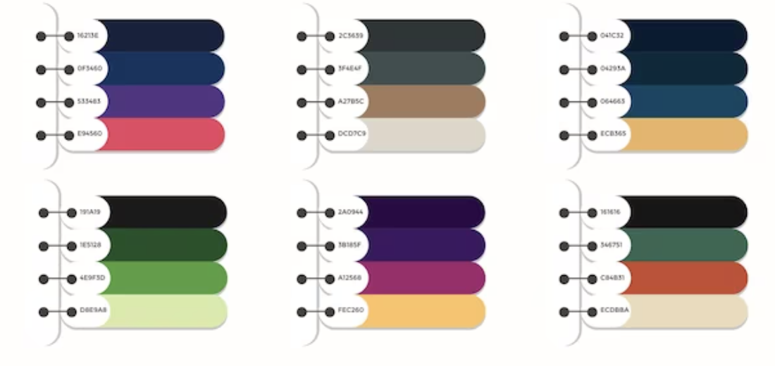
Caption
Tuning direction
Monitor
Expand memory bandwidth; Find the right ratio!
Monitor
Estimator
Tuner
20% performance gain over full DRAM & 50:50
Tuner
IPC, L1_miss_latency, DDR_latency
Estimator
Estimated
system state
Notes:
To this end, we propose Caption.
<click>
Caption is a general framework that aims to expand the system memory bandwidth by finding the right ratio.
It has three components
<click>
The monitor module may track the performance counters from the OS as well as the hardware, such as IPC, L1 miss latency, and DDR latency
<click>
The raw value of these counters are passed to the estimator module, where estimator module may deploy some modeling and machine learning techniques to find the correlation between the system state.
<click>
The estimated system state is then passed to the tuner module,
which tunes the CXL memory allocation ratio to a particular direction in a greedy approach.
Gradually, the CXL memory ratio will converge to the optimal ratio for memory bandwidth expansion.
<click>
With 7 rigorous tests cases, we found that Caption can provide as much as 20% performance gain compared to using all DRAM or the default 1:1 memory interleave scheme.

Slide 17

Conclusion
CXL != NUMA
Design-depended performance
Better efficiency in some cases
Cache-coherence
CXL has huge potential!
Use it for the right app
Choose the right allocation ratio
Caption
Choose the right ratio for you : )
Both memo and Caption are open-sourced
https://github.com/ece-fast-lab/cxl_type3_tests
Notes:
To conclude this work, we found that
<click>
CXL memory are very different from NUMA
<click>
As it has a highly design-dependent performance,
<click>
A better transfer efficiency thanks to the cache-coherence optimization that it enjoys
<click>
Additionally, we found CXL has a huge potential, but only if one uses it correctly.
<click>
we must choose carefully for the application to run on CXL memory,
<click>
and we must choose the right allocation ratio to CXL memory.
<click>
Finally, we presented Caption, a general tunning scheme that adjusts the allocation ratio for you.
<click>
Both memo and caption are open-sourced, here is the link and QR code to our public GitHub repository.
Thank you very much! I'm happy to take questions.

Slide 18
Back up
Notes:
To conclude this work, we found that
<click>
CXL memory are very different from NUMA
<click>
As it has a highly design-dependent performance,
<click>
A better transfer efficiency thanks to the cache-coherence that it enjoys
<click>
Additionally, we found CXL has a huge potential, but only if one use it correctly.
<click>
One must choose carefully for the application to run on CXL memory,
<click>
and one must choose the right allocation ratio to CXL memory.
<click>
Finally, we presented Caption, a general tunning scheme that adjusts the allocation ratio for you.
<click>
Both memo and caption are open-sourced, here is the link and QR code to our public GitHub repository.
Thank you very much!

Slide 19
TPP vs. Caption
Cores
Node 0
Page migration (TPP)
Migrate far memory to close memory
Aim for higher fast-tier locality
Does not aim for throughput
Page allocation (Caption)
Interleave memory allocation to nodes
Aim to balance the memory bandwidth to the DDR and CXL link
Yield higher system memory bandwidth
Mem
Node 0
Mem
Node 1
Page
Page
Cores
Node 0
3:1 traffic
Mem
Node 0
Mem
Node 1
Page
Page
Page
Page
Page
Page
Page
Page
Page
Page
Page
Page
Page
Page
Page
Page

Slide 20
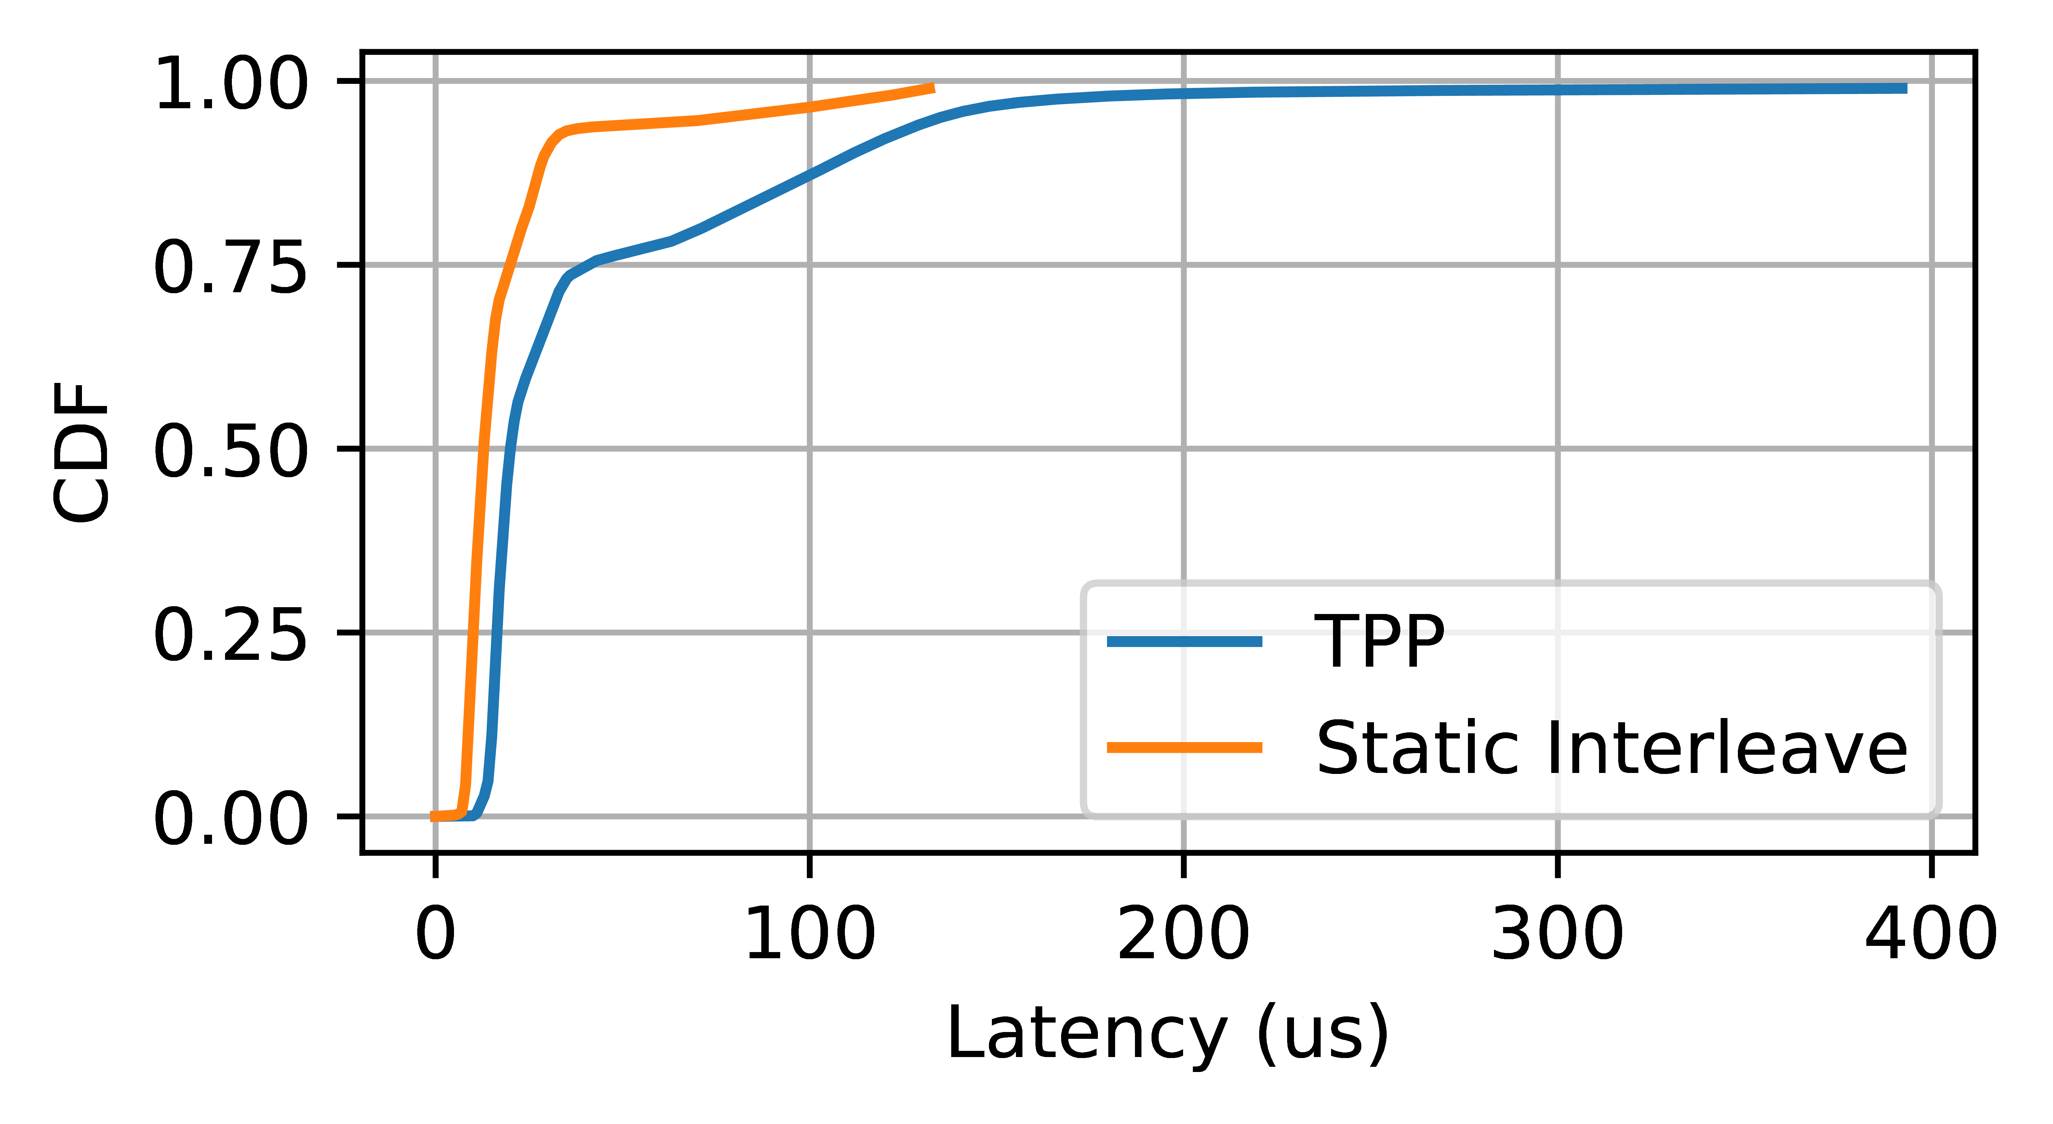
TPP vs. Caption
Page migration
Placement decision is made at runtime
Decision is based on
OS far memory detection (numa faults)
Access history (LRU / access frequency)
Migration & detection overheads are not negligible

